Slide 1
Fundamentals Plan 2002
Draft
Presented by Hunter Shively

Slide 2
Fundamentals IT Budgets
Gas – $2,580,812
Power – $2,162,963
Industrial Markets – $510,499
Global Markets – $694,791
Research – $0 (included in Gas)
Total – $5,949,065

Slide 3
Proposed IT Changes
Consolidate Budgets into one function
Group focus on one platform
Information presented in consistent format across organization
Leverage existing IT skills
Cut staff and costs by x%

Slide 4
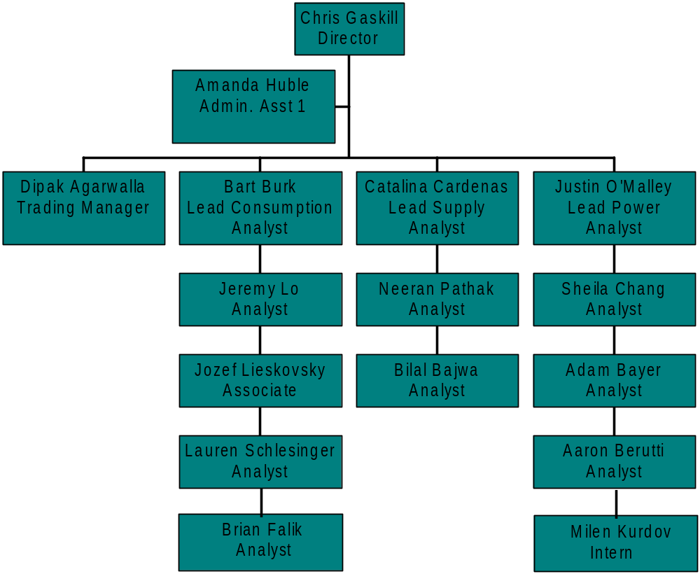
Current Fundamentals Structure

Slide 5
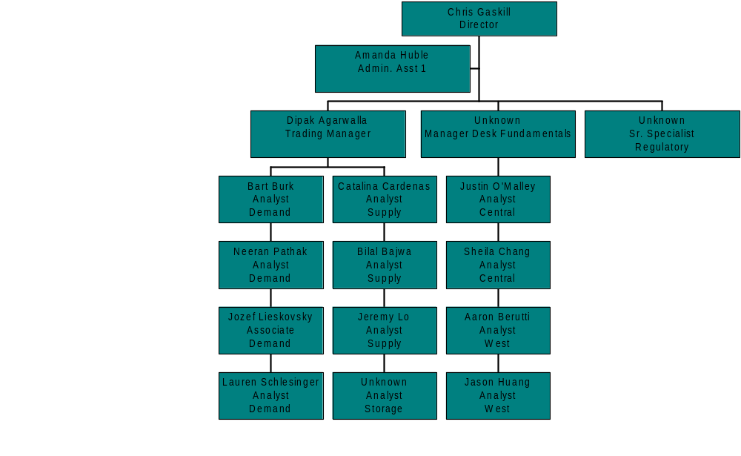
Proposed Fundamentals Structure

Slide 6
Benefits of New Structure
Analysis driven by trading desks
Accountability with new subject matter expert in fundamentals
Focus on operations data analysis and presentation
Build daily interaction with traders and desk heads to improve fundamentals function
Regulatory information research and communication standardized

Slide 7
Hurdles to New Structure
Two additional members of permanent staff (currently only three)
Finding qualified candidates

